Slide 1
CS411 – Big Data & Cloud Computing
Cao Tien Dung, PhD

Slide 2
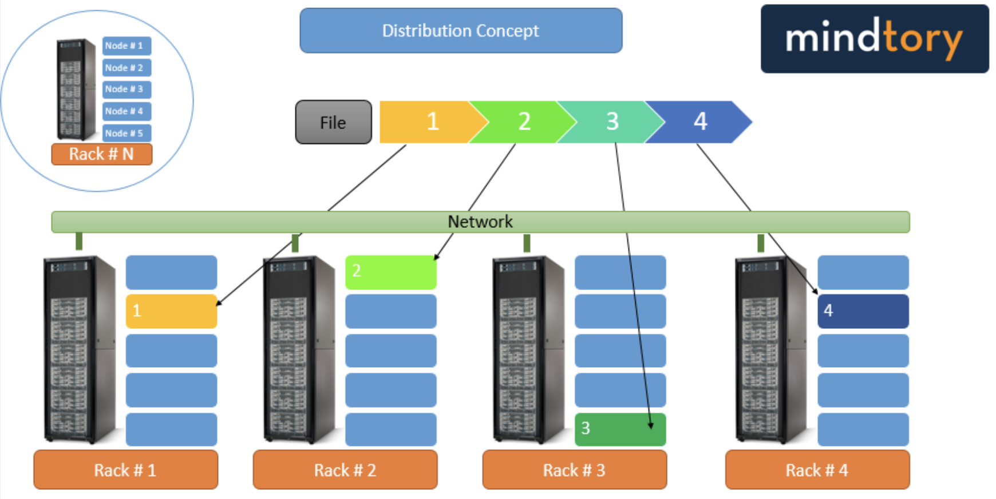
Distributed File Systems (DFS)
A distributed file system stores and provides access to files across multiple networked nodes.➔ Scalable storage and access

Slide 3
Replication in DFS
Replication stores copies of data blocks on different DataNodes (and, when possible, different racks). Key benefits:
Fault tolerance: data remains available when a disk, DataNode, or rack fails.
Read throughput: clients can read block replicas in parallel and choose nearby replicas.

Slide 4
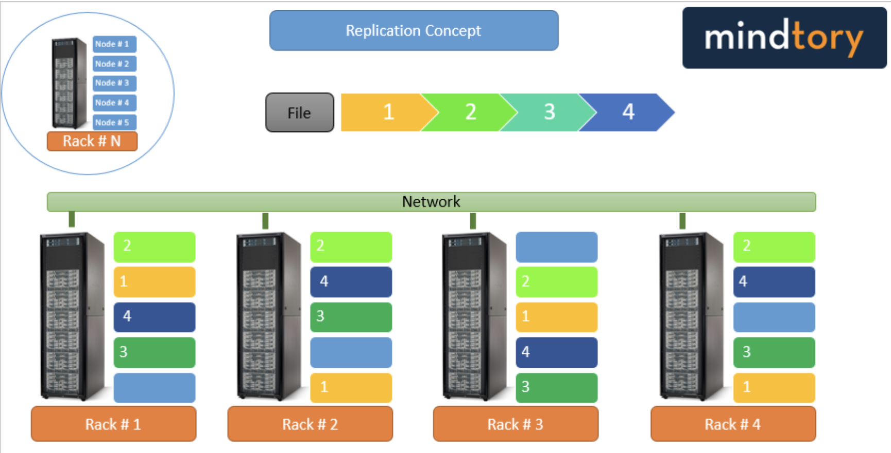
Replication

Slide 5
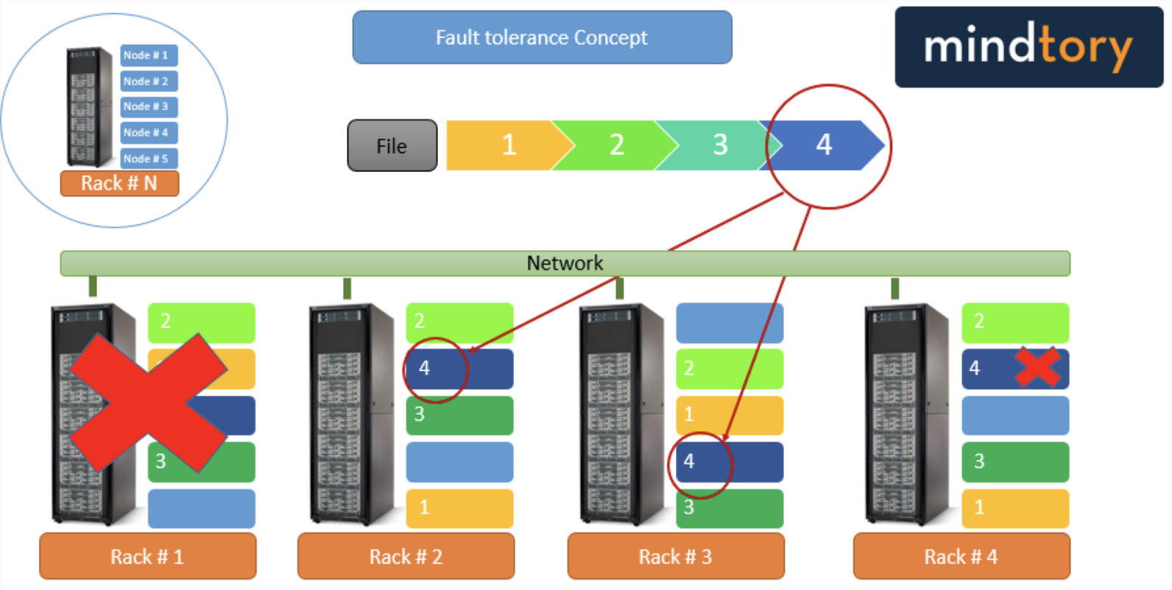
Fault tolerance

Slide 6
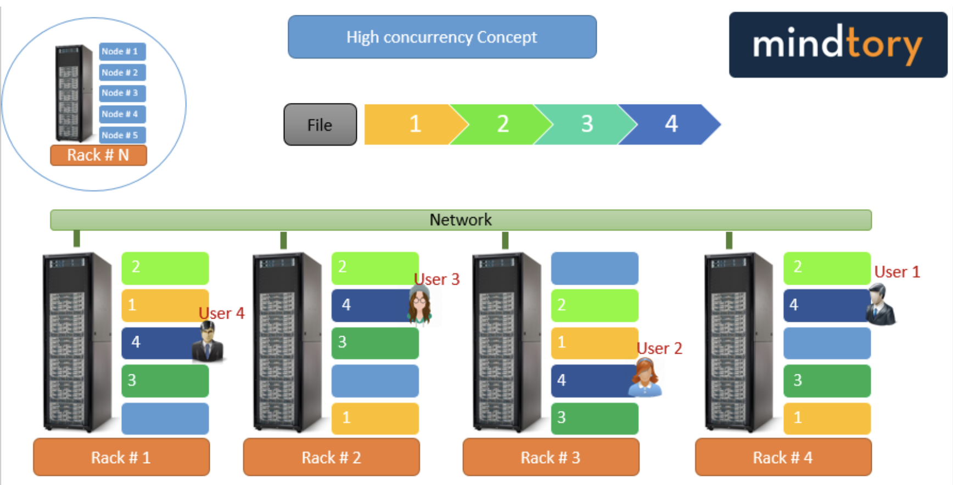
Parallel reads

Slide 7
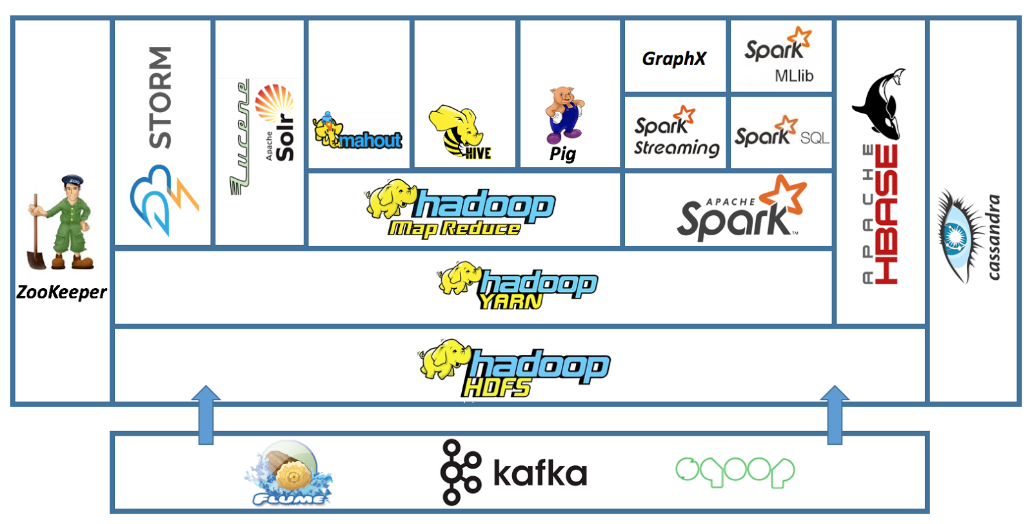
Hadoop Distributed File System (HDFS)
HDFS: distributed storage for the Hadoop ecosystem
Scalability
Reliability

Slide 8
HDFS
Designed for large files and high-throughput, streaming access
Scale-out storage on commodity servers
Files are split into configurable-size blocks
Replication supports fault tolerance
Files are divided into blocks of a configurable size.
Manager/worker architecture
A basic cluster has an active NameNode and multiple DataNodes
NameNode manages the namespace and block metadata
DataNodes store and serve blocks
Typically one DataNode process per worker machine
Default replication is commonly 3; it is configurable per file

Slide 9
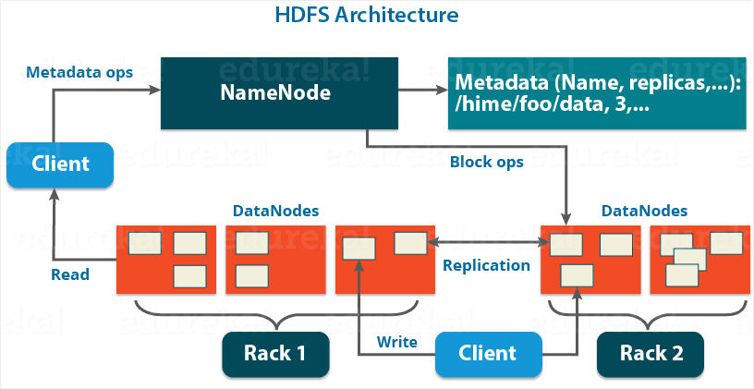
HDFS

Slide 10
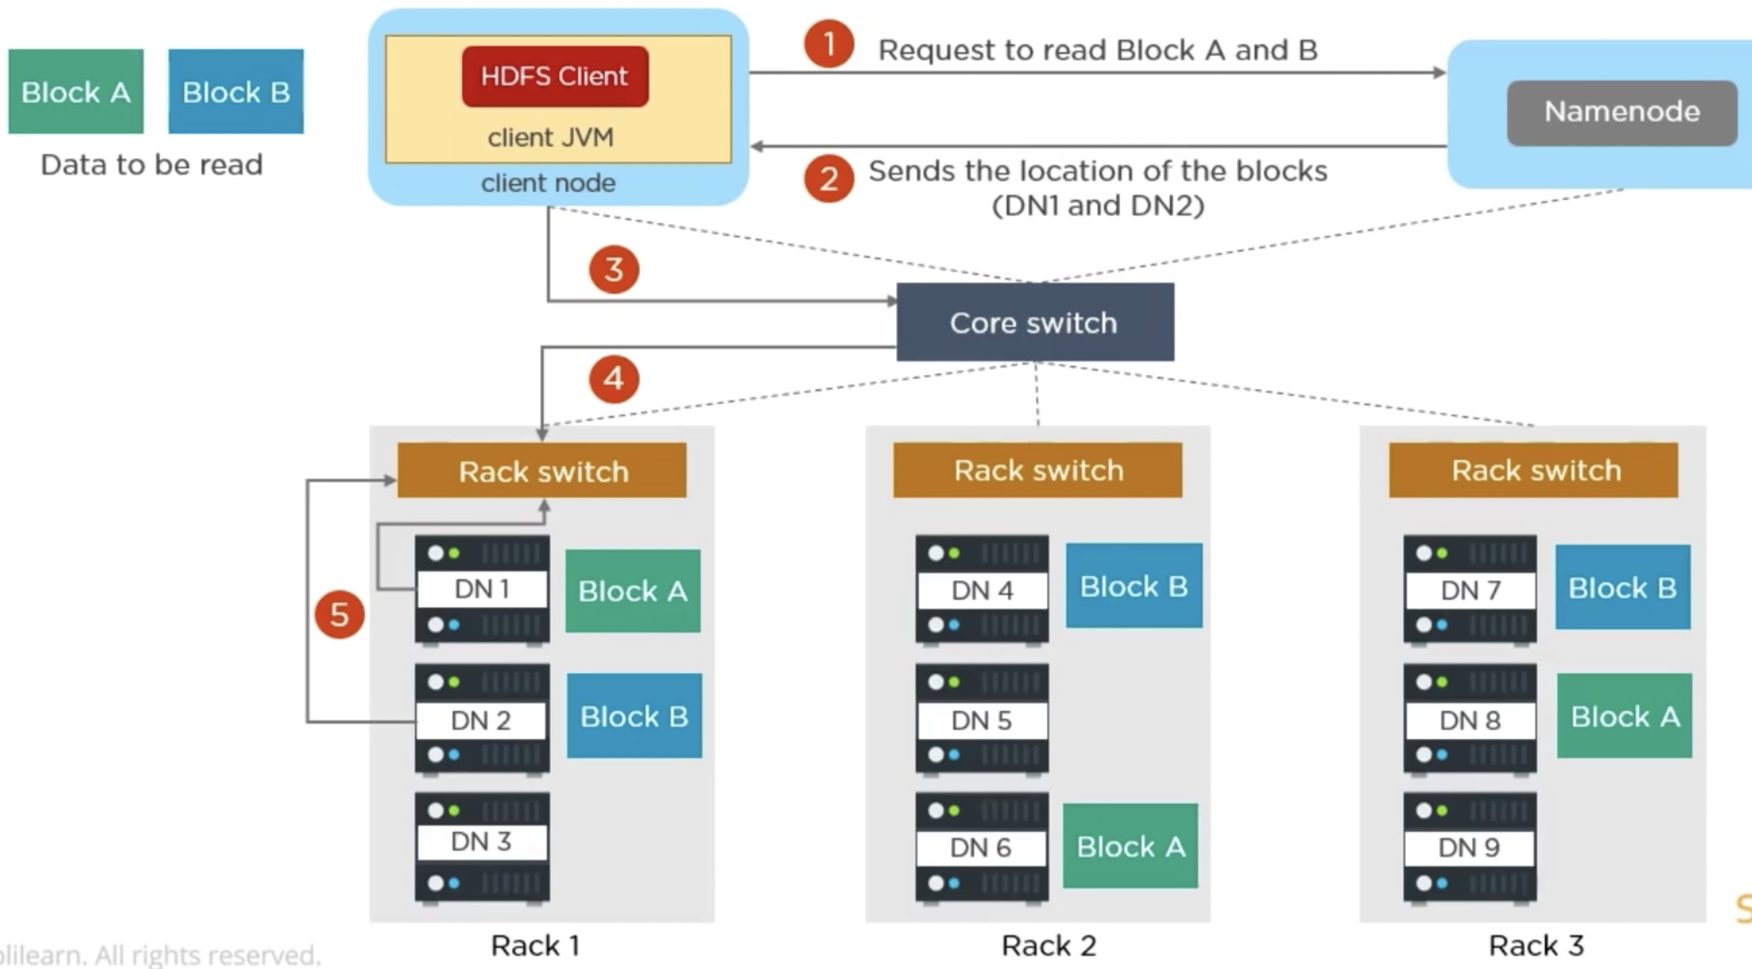
HDFS – Read Mechanism

Slide 11
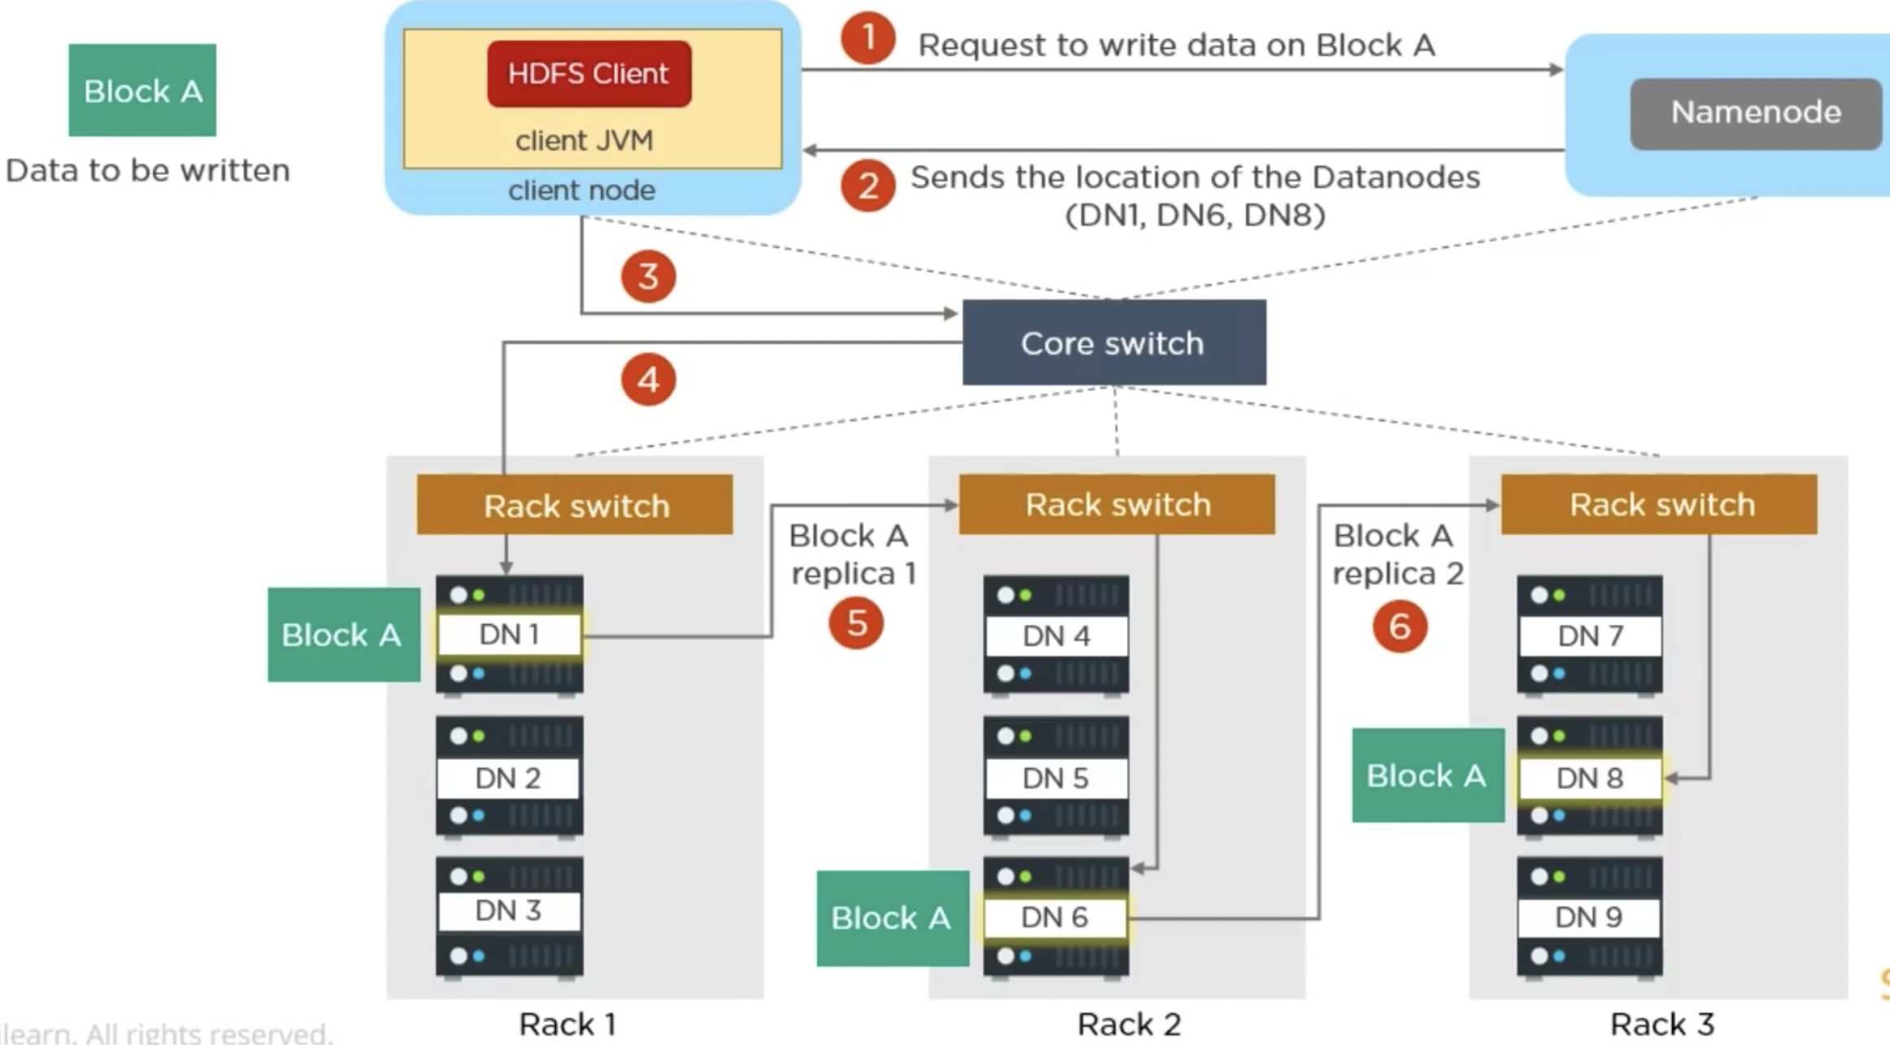
HDFS – Write Mechanism

Slide 12
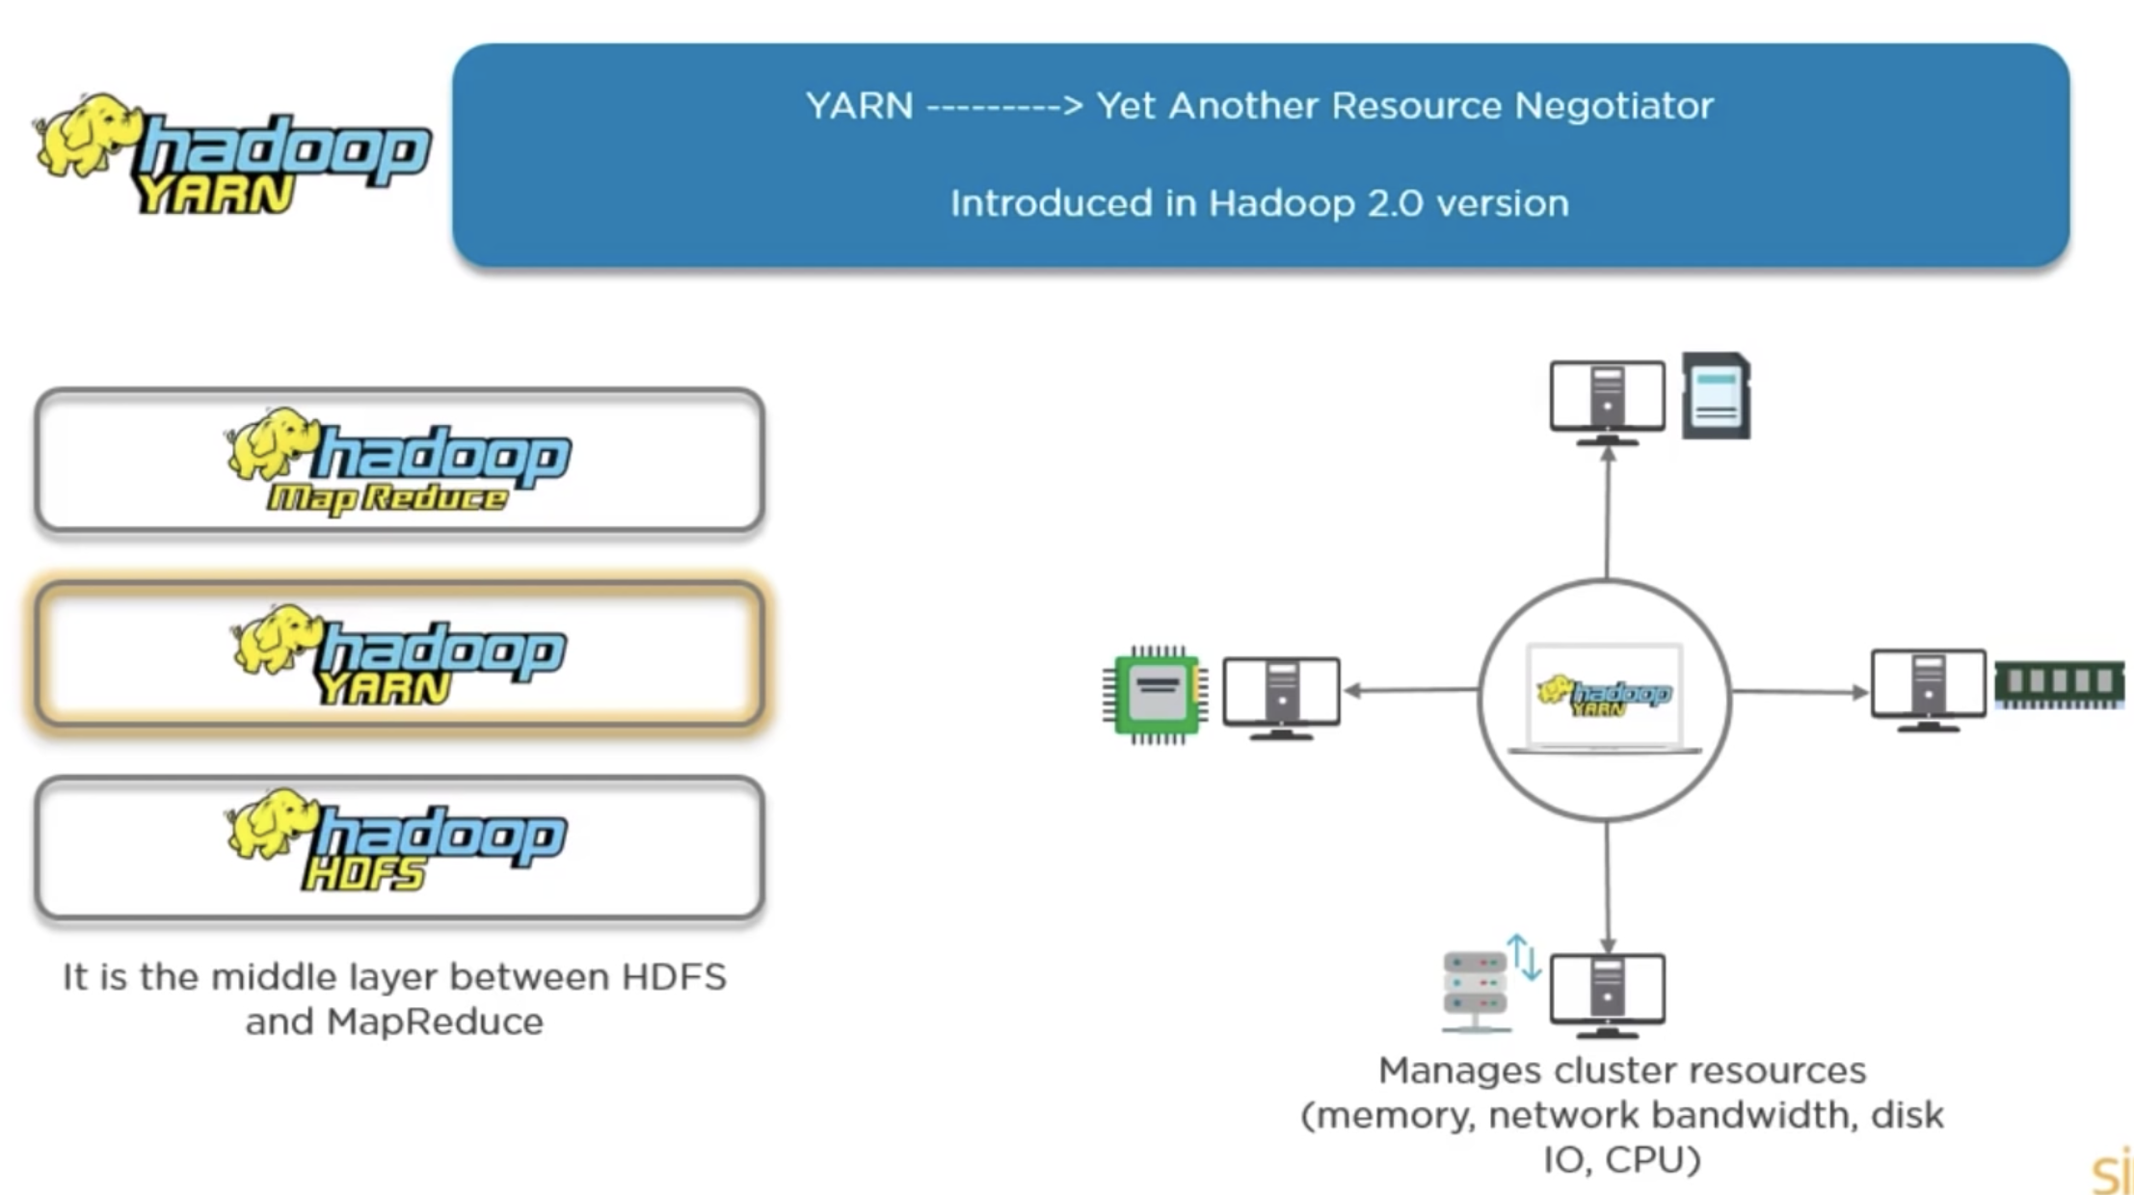
YARN

Slide 13
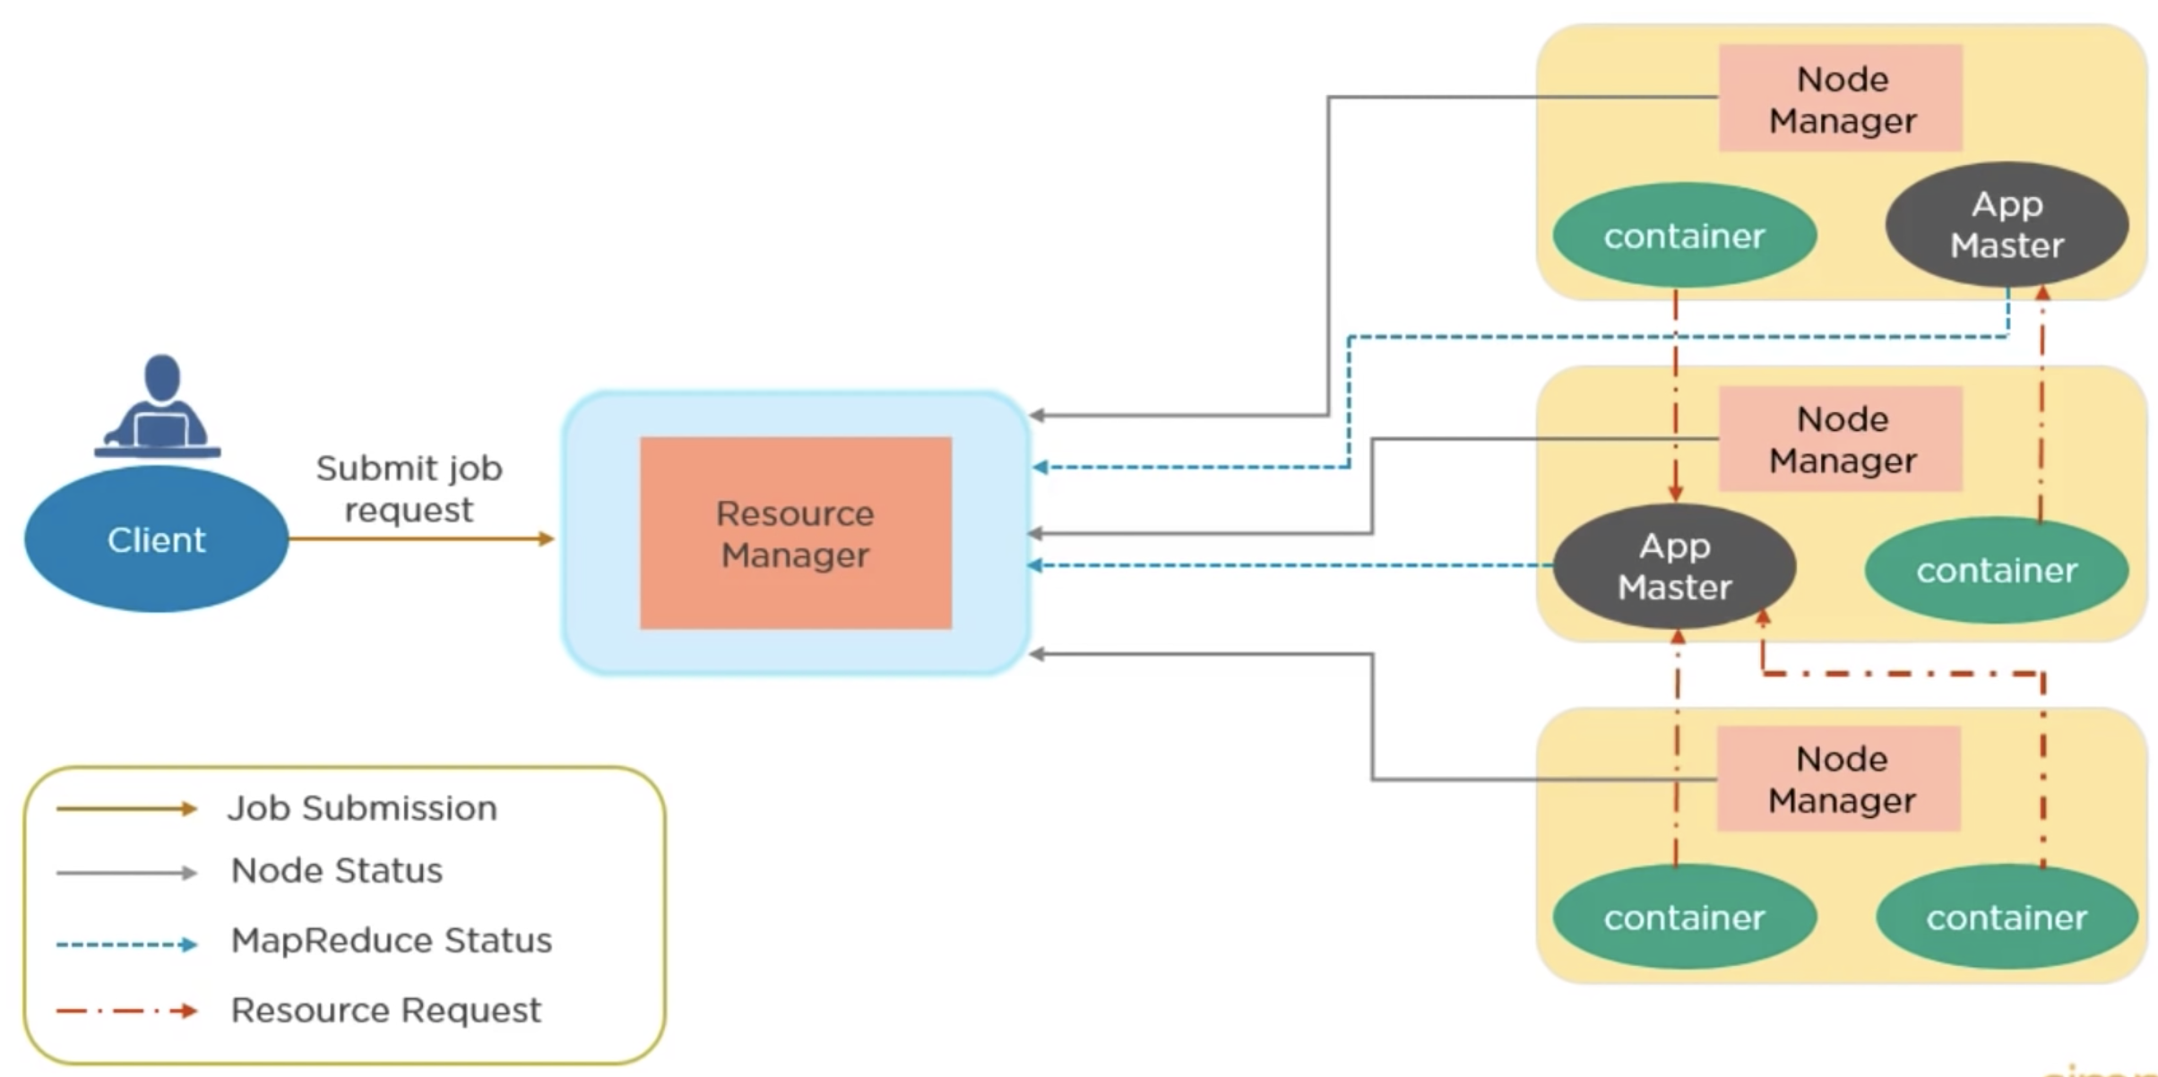
YARN elements
ResourceManager (cluster-wide resource arbitration)
ApplicationMaster (one per application attempt)
NodeManagers (one per worker node)
Container (allocated resources for a task/process)

Slide 14
Steps to Running an application in YARN
1. Client submits the application to the ResourceManager
2. ResourceManager allocates a container for the ApplicationMaster
3. ApplicationMaster registers and requests task containers
4. NodeManagers launch the allocated task containers
5. Tasks run; ApplicationMaster monitors progress and reports status

Slide 15
MapReduce: Distributed Batch Processing
1. Input in HDFS is divided into logical input splits
2. Map transforms records into intermediate key-value pairs3. Shuffle partitions, transfers, and sorts records by key
4. Reduce aggregates values for each key
5. Output is committed to a new HDFS directory
Cao Tien Dung, PhD
15

Slide 16
WordCount: Map → Shuffle/Sort → Reduce
Input: hadoop hdfs hadoop
Map: (hadoop,1) (hdfs,1) (hadoop,1)
Shuffle/Sort: hadoop → [1,1]; hdfs → [1]
Reduce: hadoop → 2; hdfs → 1
Output: part-r-00000 in HDFS

Slide 17
HDFS Design Trade-offs
Optimized for large files and high-throughput sequential access
Write-once, read-many is the common access pattern
Data locality reduces network transfer for distributed processing
Not ideal for many tiny files, low-latency updates, or random writes
NameNode metadata capacity must be planned and monitored

Slide 18
Hadoop 3.x and Hadoop 3.5.0
Hadoop 3.5.0 server processes require Java 17
Erasure coding can reduce storage overhead for suitable HDFS data
Multiple standby NameNodes improve high-availability options
Service ports moved away from the Linux ephemeral port range
Hadoop 3.5 adds HDFS optimizations and a GCS filesystem connector

Slide 19
Replication vs. Erasure Coding
Replication: complete block copies; simple recovery and fast reads
Erasure coding: data + parity cells; lower storage overhead
EC recovery uses reconstruction and adds CPU/network work
Choose by access pattern, recovery target, and storage cost
Single-node Colab cannot demonstrate either mechanism's real resilience

Slide 20
Chapter 2 Practice and References
Run: Hadoop_Practical_Online_Colab.ipynb
Observe: HDFS blocks, replication, YARN, and MapReduceExtend: compare Hadoop Streaming with PySpark DataFrames
Apache Hadoop 3.5.0: https://hadoop.apache.org/docs/r3.5.0/
FileSystem Shell and Single Node Setup are linked in the lab README
Cao Tien Dung, PhD
20

